Slide 1



40º Jornadas de SADAF
Capitalización y desempeño bancario:
evidencia de bancos argentinos en períodos de crisis
Martín Dutto
Emiliano Carlevaro
Universidad Nacional del Litoral
(Argentina)
University of Western Australia
(Australia)

Slide 2
¿Por qué el capital bancario?
Riesgo sistémico
Corridas bancarias (contagio)
Asignación de riesgo
Sistema de pago (skin in the game)
¿Es más capital más costoso? Modigliani-Miller de nuevo…
Equilibrio parcial
Sí
Aumenta el costo de financiamiento.
No mejora eficiencia (Townsend 1979; Calomiris, Kahn 1991)
Equilibrio general
Depende
Puede reducir el costo de financiamiento (Begenau 2020).
Incrementa eficiencia: monitoreo (Holstrom, Tirole 1997).
A bancos mejor capitalizados ¿les va mejor durante una crisis?
Notes:
Systemic risk: disruption in the payment system
Isk allocation: too much r
isk, inefficient firms financed. Low risk, good firms are not financed.
DEPÓSITOS son mejores que capital.
CAPITAL INCREASES PROFITS
Capital can provide ¿incentives? To monitor firms. Monitoring techonology (as in Holström & Tirole, 1997) enhances firms payoffs (as opossed to higher loan rate)
Dep’ositos es la forma preferida de financiar un banco. (Townsend 1979; Calomiris, Kahn 1991)
QUESTIONS?

Slide 3
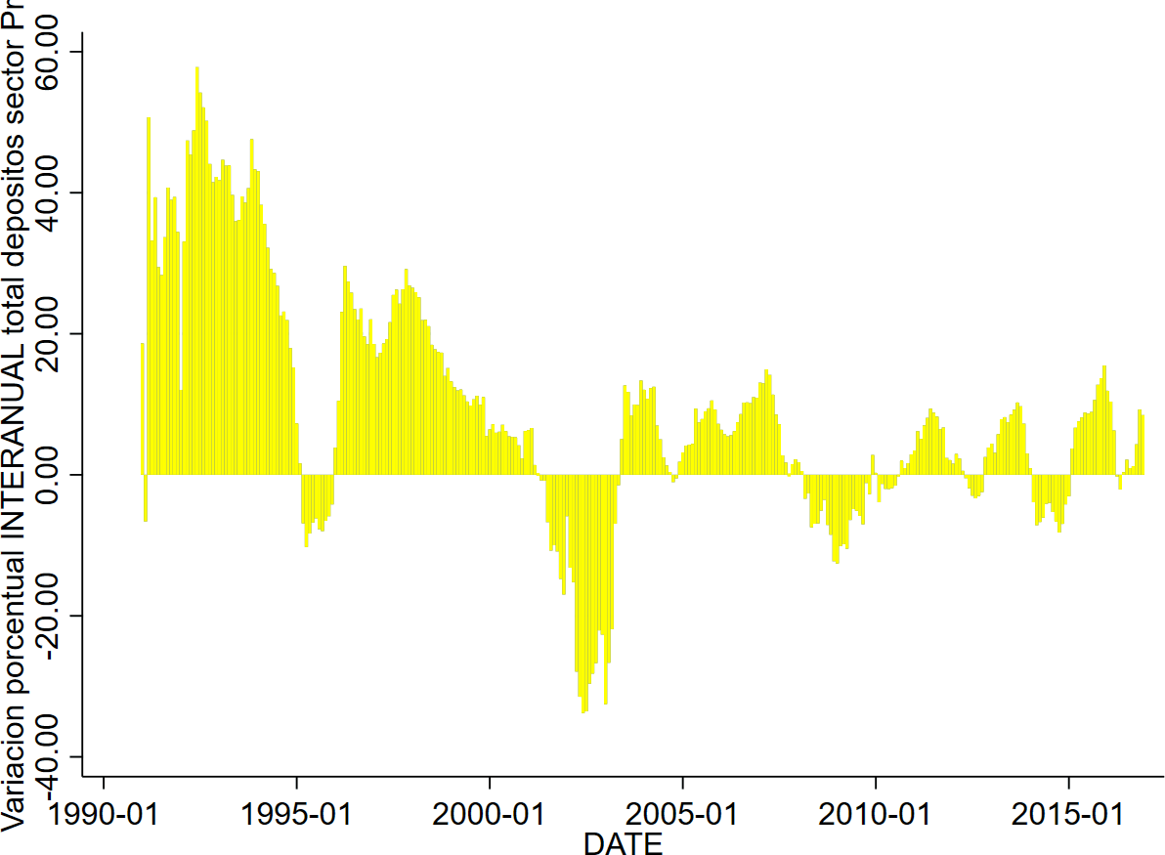
Crisis Tequila
Crisis 2001/2002
Crisis del campo
40%
20%
Cambio % depósitos interanual
0%
-20%
1990
1995
2000
2005
2010
2015
Asia, Rusia, Samba(Brasil)
CFG
Notes:
Samba or capiriña crisis
Pre-crisis 09-1998 09-2000
Crisis 2001 10-2000 05-2003
Pre-normal 06-2003 06-2005
Normal (fake-crisis) 07-2005 07-2006
Pre-crisis 08-2006 04-2008
Crisis 2008 05-2008 12-2008
Pre-normal 01-2009 01-2011
Normal (fake-crisis) 02-2011 02-2012
Pre-normal 03-2012 03-2014
Normal (fake-crisis) 04-2014 11-2015

Slide 4







Pre-normal
Normal
Pre-normal
Normal
Pre-crisis
Crisis
1990
1995
1995
2000
2005
2010
2015
$${∆CuotaMercado}_{t}$$
$${= β CAP}_{t−1}$$
BERGER, BOUWMAN (2013)
JFE, How does capital affect bank performance during financial crises?
$${∆MktShare}_{t}$$
$${= β}_{}^{c}\left(s_{t}^{c}\right)CAP_{t−1}$$
$$+ β^{\sim c} CAP_{t−1}$$

Slide 5






Pre-normal
Normal
Pre-crisis
Crisis
1990
1995
1995
1996
1997
1998
1999
2000
2001
2005
2010
2015
$${∆CuotaMercado}_{t}$$
$${= β CAP}_{t−1}+ε_{i,t}$$
BERGER, BOUWMAN (2013)
$$β^{\sim c}$$
JFE, How does capital affect bank performance during financial crises?
$${∆CuotaMercado}_{t}$$
$${= β}_{}^{c}\left(I_{t}^{c}\right)CAP_{t−1}$$
$$+ β^{\sim c}\left(\sim I_{t}^{c}\right)CAP_{t−1}+ε_{i,t}$$
Pre-normal
Normal
$$β^{c}$$
Pre-crisis
Crisis

Slide 6



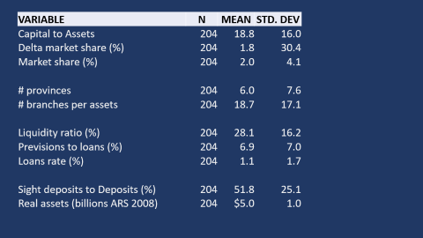

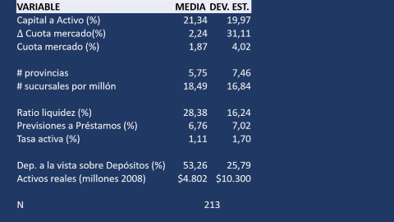




Pre-crisis
Crisis
Pre-normal
Normal
Pre-crisis
Crisis
Pre-normal
Normal
Pre-crisis
Crisis
Pre-normal
Normal
Pre-normal
Normal
1993
1994
1995
1996
1997
1998
1999
2000
2001
2002
2003
2004
2005
2006
2007
2008
2009
2010
2011
2012
2013
2014
2015
$${∆CuotaMercado}_{t}$$
$${= β}_{}^{c}\left(I_{t}^{c}\right)CAP_{t−1}$$
$$+ β^{\sim c}\left({\sim I}_{t}^{c}\right)CAP_{t−1}$$
$${+ γ^{′} X}_{t−1}$$
$$+ Crisis_{t}$$
$${+ {Banco}_{i}+ε_{i,t}}_{i}$$
ESTRUCTURA
Tamaño
# sucursales
LIQUIDEZ & FONDEO
${Depósitos}/{PASIVO}$ ${A. Liquidos}/{ACTIVO}$
# provincias
Propietario
RIESGO PORTFOLIO
Tasas activas; ${Previsiones}/{Préstamos}$
Pre-crisis
Crisis
Notes:
Size is market share or assets in real terms
Owner: private bank, cooperative, state-owned QUESTIONS!
Pre-crisis 09-1998 09-2000
Crisis 2001 10-2000 05-2003
Pre-normal 06-2003 06-2005
Normal (fake-crisis) 07-2005 07-2006
Pre-crisis 08-2006 04-2008
Crisis 2008 05-2008 12-2008
Pre-normal 01-2009 01-2011
Normal (fake-crisis) 02-2011 02-2012
Pre-normal 03-2012 03-2014
Normal (fake-crisis) 04-2014 11-2015

Slide 7

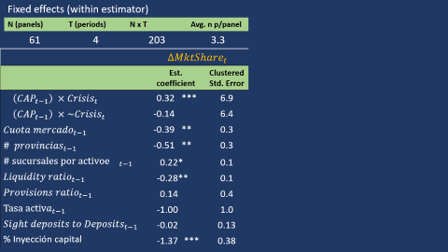






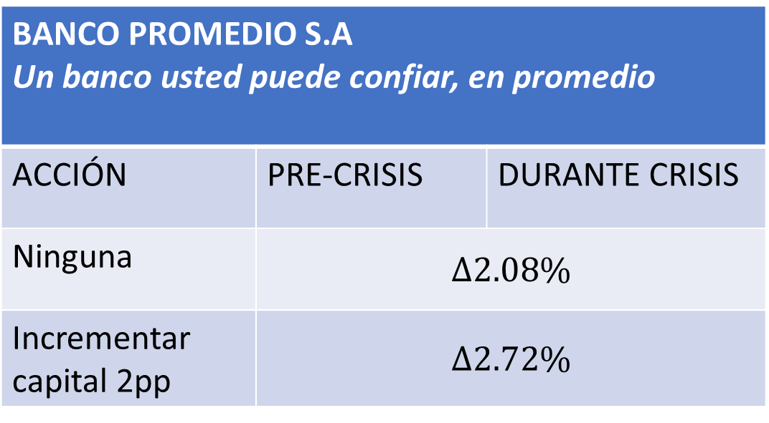








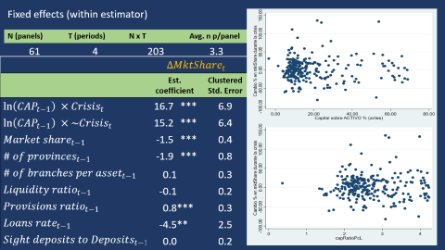
Pre-crisis
Crisis
Pre-normal
Normal
Pre-crisis
Crisis
Pre-normal
Normal
Pre-crisis
Crisis
Pre-normal
Normal
Pre-normal
Normal
1993
1994
1995
1996
1997
1998
1999
2000
2001
2002
2003
2004
2005
2006
2007
2008
2009
2010
2011
2012
2013
2014
2015
$${∆MktShare}_{t}$$
$${= β}_{}^{c}\left(I_{t}^{c}\right) ⁡CAP_{t−1}$$
$$+ β^{\sim c}\left({\sim I}_{t}^{c}\right) CAP_{t−1}$$
$${+ γ^{′} X}_{t−1}$$
$$+ Crisis$$
$${+ Banco+ε_{i,t}}_{i}$$
$$β^{c}=$$
$$0.32$$
$$2 pp$$
$$0.64\%$$
Pre-crisis
Crisis
BANCO PROMEDIO S.A Un banco usted puede confiar, en promedio
ACCIÓN | PRE-CRISIS | DURANTE CRISIS
Ninguna | $$Δ2.08\%$$
Incrementar capital 2pp | $$Δ2.72\%$$
$$β^{\sim c}=$$
$$−0.14$$
Pre-normal
Normal
$16.$7
Pre-crisis
Crisis
$$β^{\sim c}=$$
$15.$2
Pre-normal
Normal
Notes:
Mean capital ratio = 19.14 %. Mean market share change: 2.08%. 2 pp mas del ratio de capital, incrementa la cuota en 0.64 pp (el promedio es 2.08%)A 10% increase in cap ratio pre crisis =~ 2% capital ratio -> increases your mkt share during crisis =~ 1.6% (the mean) Average capital ARS08 =~ $ 950 millions. Average assets ARS08 =~ $ 5billion () Increase capital in 2% * $5 billion-> Delta 1.6% = 1.6% * $ 5billion =

Slide 8








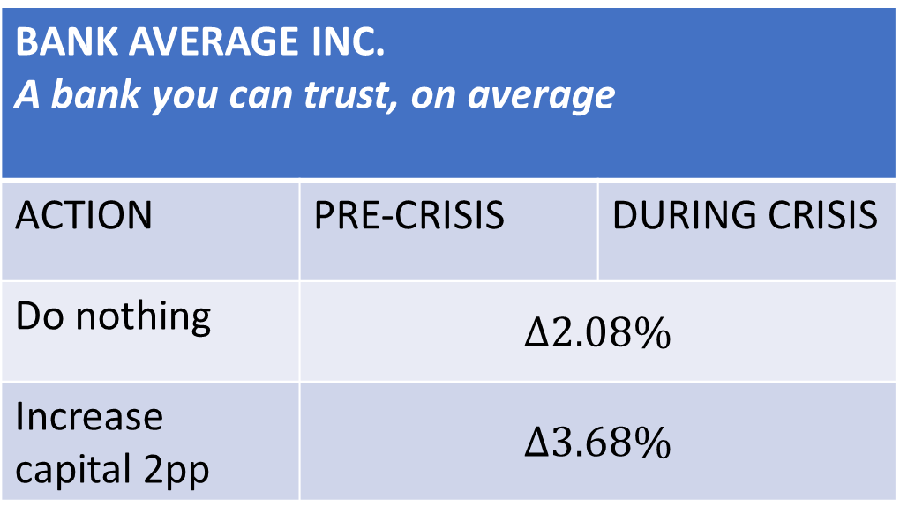









Pre-crisis
Crisis
Pre-normal
Normal
Pre-crisis
Crisis
Pre-normal
Normal
Pre-crisis
Crisis
Pre-normal
Normal
Pre-normal
Normal
1993
1994
1995
1996
1997
1998
1999
2000
2001
2002
2003
2004
2005
2006
2007
2008
2009
2010
2011
2012
2013
2014
2015
$${∆MktShare}_{t}$$
$${= β}_{}^{c}\left(I_{t}^{c}\right)CAP_{t−1}$$
$$+ β^{\sim c}\left({\sim I}_{t}^{c}\right)CAP_{t−1}$$
$${+ γ^{′} X}_{t−1}$$
$$+ Crisis$$
$${+ Banco}_{i}+ε_{i,t}$$
$$β^{c}=$$
$$2 pp$$
$$0.64\%$$
$$2 pp$$
$$1.44\%$$
$$0.32$$
$$β^{c}=$$
Pre-crisis
Crisis
$$0.72$$
Pre-crisis
Crisis
$$β^{\sim c}=$$
$$−0.14$$
Pre-normal
Normal
$$β^{\sim c}=$$
$$−0.13$$
Pre-normal
Normal
BANK AVERAGE INC. A bank you can trust, on average
ACTION | PRE-CRISIS | DURING CRISIS
Do nothing | $$Δ2.08\%$$
Increase capital 2pp | $$Δ3.68\%$$
Notes:
Mean capital ratio = 19.14 %. Mean market share change: 2.08%. A 10% increase in cap ratio pre crisis =~ 2% capital ratio -> increases your mkt share during crisis =~ 1.6% (the mean) Average capital ARS08 =~ $ 950 millions. Average assets ARS08 =~ $ 5billion () Increase capital in 2% * $5 billion-> Delta 1.6% = 1.6% * $ 5billion =

Slide 9
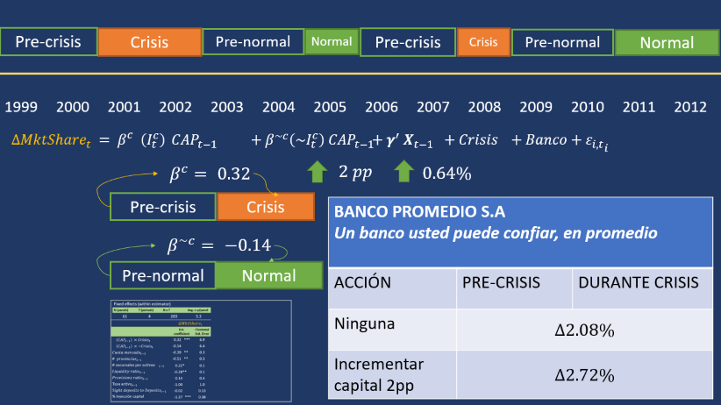
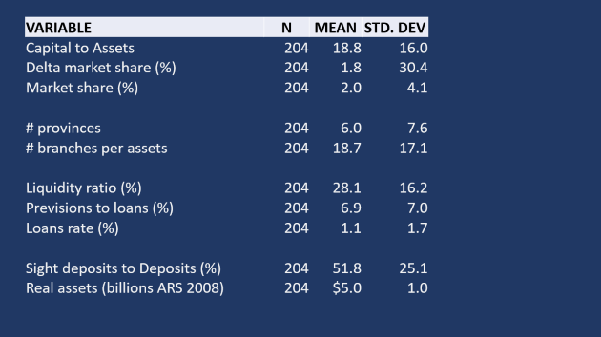

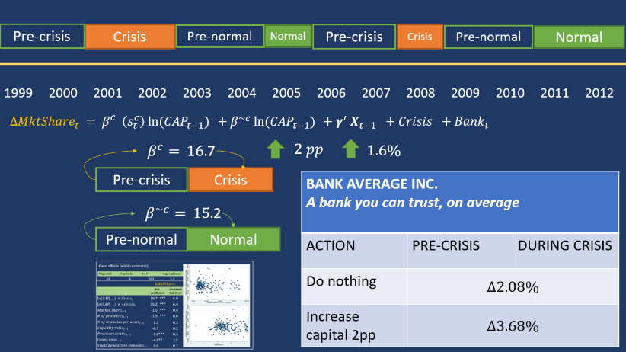
Comentarios finales
Pre-normal
Normal
Capitalización es relevante
2013
2014
2015
¿Sólo durante crisis?
Inyección de capital durante crisis
¿El tamaño importa?
Análisis de supervivencia
Notes:
Mean capital ratio = 19.14 %. Mean market share change: 2.08%. A 10% increase in cap ratio pre crisis =~ 2% capital ratio -> increases your mkt share during crisis =~ 1.6% (the mean) Average capital ARS08 =~ $ 950 millions. Average assets ARS08 =~ $ 5billion () Increase capital in 2% * $5 billion-> Delta 1.6% = 1.6% * $ 5billion =

Slide 10
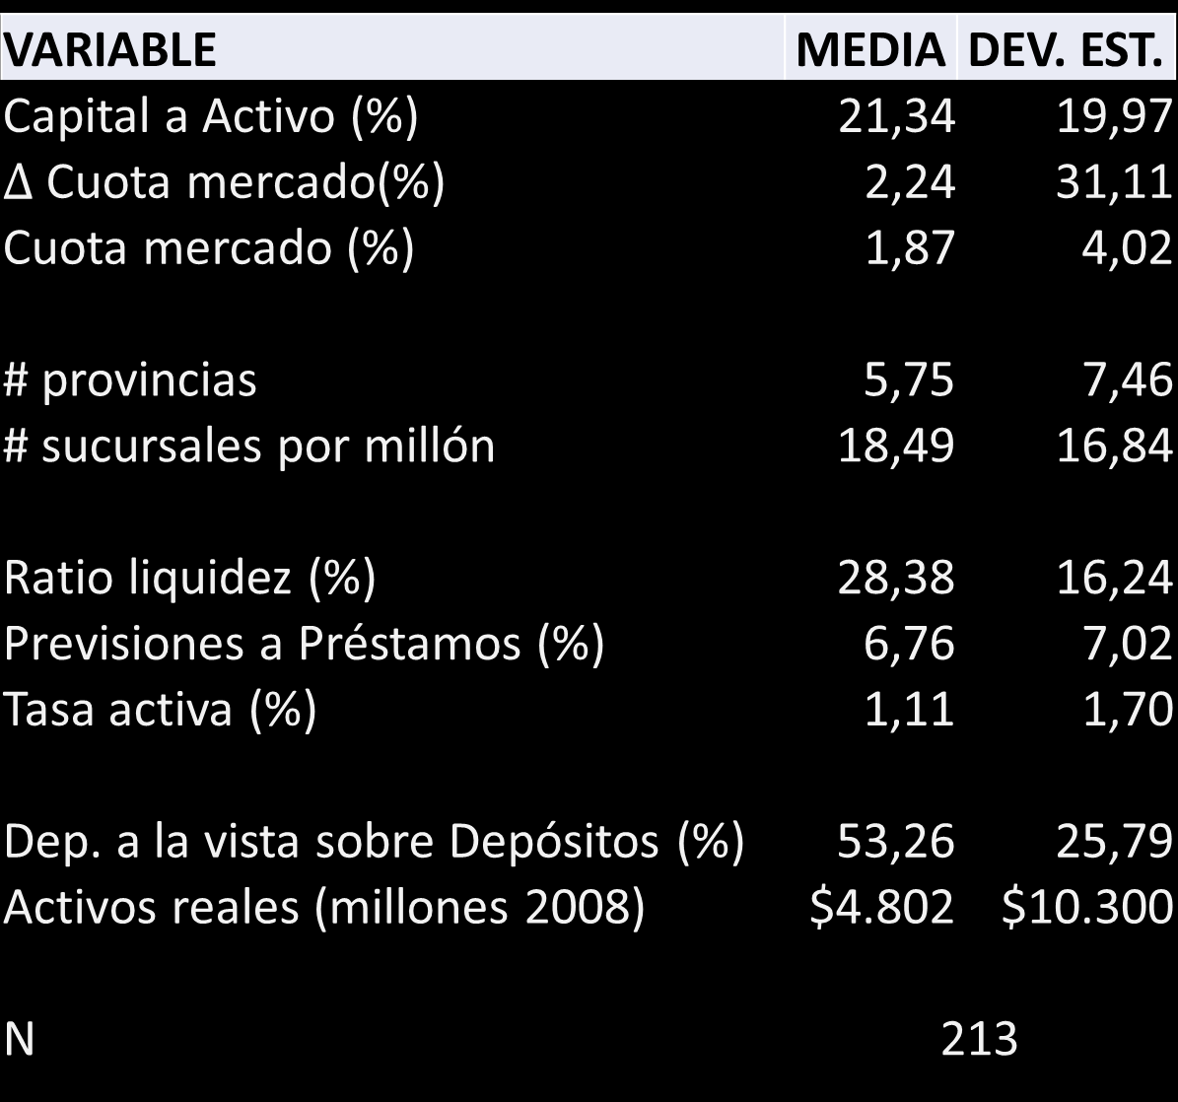
VARIABLE | MEDIA | DEV. EST.
Capital a Activo (%) | 21,34 | 19,97
$∆$ Cuota mercado(%) | 2,24 | 31,11
Cuota mercado (%) | 1,87 | 4,02
# provincias | 5,75 | 7,46
# sucursales por millón | 18,49 | 16,84
Ratio liquidez (%) | 28,38 | 16,24
Previsiones a Préstamos (%) | 6,76 | 7,02
Tasa activa (%) | 1,11 | 1,70
Dep. a la vista sobre Depósitos (%) | 53,26 | 25,79
Activos reales (millones 2008) | $4.802 | $10.300
N | 213
Notes:
Mean capital ratio = 19.14 %. Mean market share change: 2.08%. A 10% increase in cap ratio pre crisis =~ 2% capital ratio -> increases your mkt share during crisis =~ 1.6% (the mean) Average capital ARS08 =~ $ 950 millions. Average assets ARS08 =~ $ 5billion () Increase capital in 2% * $5 billion-> Delta 1.6% = 1.6% * $ 5billion =

Slide 11
ASSETS | N
LIQUID ASSETS | DEPOSITS
 | Sight deposits
 | Time deposits
LOANS
 | BONDS
OTHER ASSETS | CAPITAL
Notes:
Mean capital ratio = 19.14 %. Mean market share change: 2.08%. A 10% increase in cap ratio pre crisis =~ 2% capital ratio -> increases your mkt share during crisis =~ 1.6% (the mean) Average capital ARS08 =~ $ 950 millions. Average assets ARS08 =~ $ 5billion () Increase capital in 2% * $5 billion-> Delta 1.6% = 1.6% * $ 5billion =

Slide 12
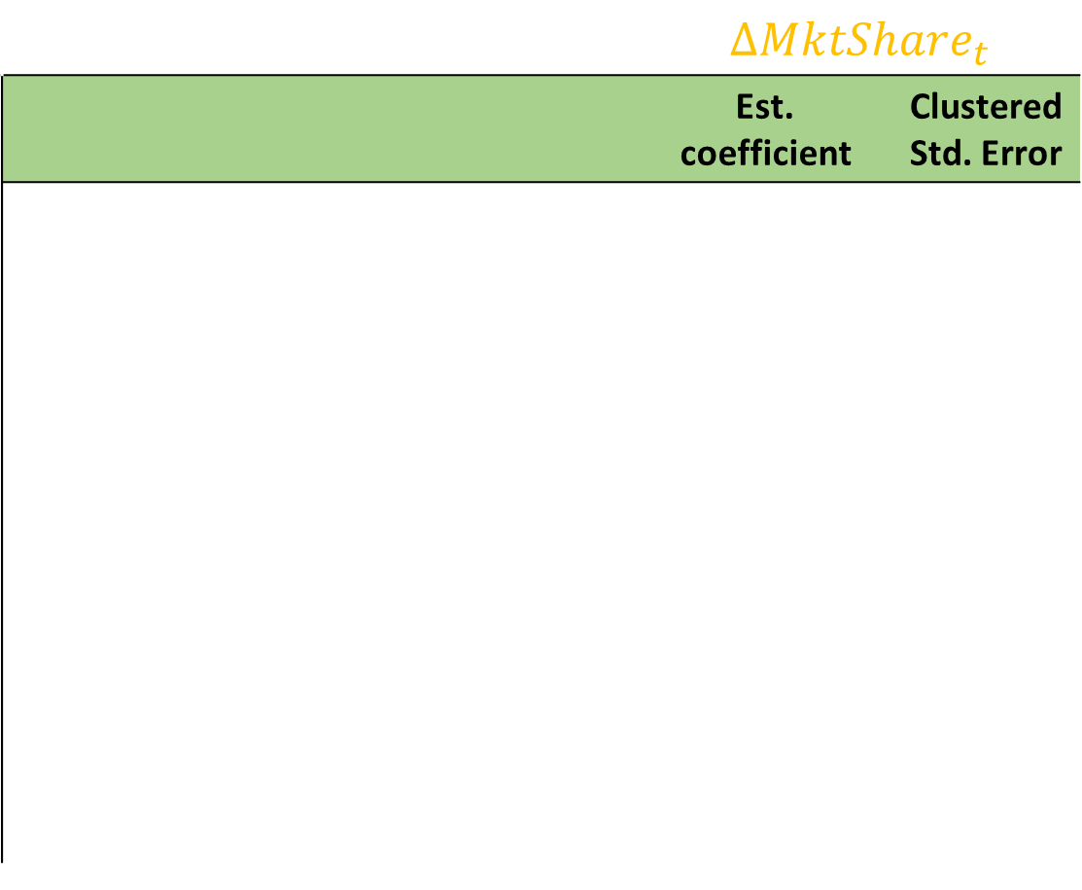
Fixed effects (within estimator)
N (panels) | T (periods) | N x T | Avg. n p/panel
61 | 4 | 203 | 3.3
 | $${∆MktShare}_{t}$$
 | Est. coefficient |  | Clustered Std. Error
$$\left(CAP_{t−1}\right) ×Crisis_{t}$$ | 0.32 | *** | 6.9
$$\left(CAP_{t−1}\right) ×\sim Crisis_{t}$$ | -0.14 |  | 6.4
${Cuota mercado}_{t−1}$ | -0.39 | ** | 0.3
$$\# {provincias}_{t−1}$$ | -0.51 | ** | 0.3
$$\# sucursales por activoe{}_{t−1}$$ | 0.22 | * | 0.1
$$Liquidity ratio_{t−1}$$ | -0.28 | ** | 0.1
$$Provisions ratio_{t−1}$$ | 0.14 |  | 0.4
$${Tasa activa}_{t−1}$$ | -1.00 |  | 1.0
$$Sight deposits to Deposits_{t−1}$$ | -0.02 |  | 0.13
% Inyección capital | -1.37 | *** | 0.38

